Slide 1
Effort Reporting Overview
Summer 2023

Slide 2
Goals of Effort Reporting Overview
The goals of Effort Reporting Overview are to gain awareness of:
  What effort reporting is.
  Why we do it.
  How we do it.
  Pre-reviewer role and responsibilities in new effort reporting system.

Slide 3
What is Effort Certification
According to the UNT Policy “Certification of Effort” is a confirmation of the work that has been performed. Each Activity is attributed a percentage of the effort during the reporting period that is reasonable in relation to 100% of total effort for all activities for which an individual is paid by UNT during a specific period.
  The charge to each award must be appropriate in relation to the work performed.
Notes:
Example: 20% effort on a project, 50% effort towards instruction, 10% effort towards administrative duties, 20% effort towards university sponsored public service
If a PI has 30% salary coming from and award but during the reporting period only puts 20% effort towards the award, the charge of 30% is not appropriate in relation to the work performed.

Slide 4
Effort Reporting Defined
Basic Definitions Highlights
  Effort:
    Work performed for UNT.
    Fraction of time devoted to any activity (teaching, committees, research, admin, etc).
    Expressed as a percentage of total UNT activity.
  Effort Certification:
    The act of confirming in that effort is correct and accurate.

Slide 5
Why do we do it and why are we looking at Effort Reporting?
Required by federal government.
Increased federal focus on effort reporting.
Typically the largest cost category.
Must minimize audit risk.
New effort reporting system Summer 2023 (ECC).
New Pre-Reviewer role in ECC system.

Slide 6
Uniform Guidance 2 CFR § 200.430: Compensation for Personal Services
General Principles:
  The distribution of salaries and wages is based on payroll.
  Apportionment of salaries and wages produces an equitable distribution based upon effort and contributed activities.
  In an academic setting, any method of apportionment recognizes that teaching, research, and service and administration are inextricably intermingled.
  Therefore, reliance is based upon estimates in which a degree of tolerance is acceptable.

Slide 7
Effort Reporting versus Payroll Distribution
Payroll Distribution:
  The basic distribution of one’s salary or origin source of pay
Effort Reporting:
  Describe the allocation of an individual’s actual time and effort spent for specific projects, whether or not reimbursed by the sponsor.

Slide 8
What Effort is NOT
It is NOT necessarily the same as payroll distribution.
It is NOT 40 hours per week.
Notes:
Salary distributions may not reflect actual effort like in the example before of someone who is receiving 30% salary from an award but only puts 20% effort on the project.
Faculty are not beholden to 40 hours a week. Total effort is representative of all activities and duties carried out for the University which may be more than 40 hours.

Slide 9
What is excluded from Effort?
Specific short-term assignments (not routine and are compensated separately)
One-time payments are not included

Slide 10
Positions normally included
Faculty positions with sponsored projects
Professional Staff positions who work on sponsored projects
Graduate Research Assistants (RAs) / Teaching Assistants (TAs) who work on sponsored projects.

Slide 11
Positions not included
Pre- and Post-doctoral individuals supported solely by a fellowship
College Work Study employees
Individuals whose work is not required to meet certain cost sharing commitments
Individuals with Voluntary Uncommitted Cost Sharing (VUCS) toward a project
Semi Monthly (Hourly) paid staff and students (Effort recorded on a timesheet)

Slide 12
Effort Reporting for Faculty
Sponsored project activities:
  Academic Year Time (direct charges and cost sharing)
  Summer Salary (direct charges)
Non-sponsored time (included in Instruction and Departmental Research):
  Teaching
  Office hours
  Student advising
  Departmental research activities
  Competitive proposal preparation
  Committee service
  Departmental meetings
  Professional development

Slide 13
Effort Reporting for Professional Staff
Professional Staff (Monthly Payroll):
  Total time spent conducting university business regardless of the hours required
  Example
    45 hrs/wk = Project A = 75%
    15 hrs/wk = proposal preparation = 25%
  Or
    $1,875 Wages/Salary charged to Project A = 75%
    $625 Wages/Salary from a departmental fund = 25%

Slide 14
Effort Reporting for Graduate RAs / TAs
Graduate RAs / TAs:
  Based upon all activities for which the student receives compensation for his/her appointment(s)
  Support from fellowships is excluded

Slide 15
Administration of Payroll & Effort
Faculty and Professional Staff payroll distribution reported on:
  Electronic Payroll Action Request (EPAR):
    Hiring
    Labor redistributions
    Terminations

Slide 16
Administration of Payroll & Effort
Non-Professional Staff and Students payroll distribution reported on:
  Timesheets
  Online EPAR (Labor Redistribution)
  Sponsored and non-sponsored time should be tracked and charged to appropriate funds.

Slide 17
New UNT Effort Reporting System ECC
During the summer of 2023 UNT will be moving to Huron’s ECC (Employee Compensation Compliance) application
Payroll Affirmation will be done on a semi-annual basis going forward, January 1st – June 30th and July 1st – December 31^{st.}
The initial pre-review time will be the months of August (begin payroll clean up on July 16th) and February (begin payroll clean up on January 16th).
PI certification with be done during the months of September and March.

Slide 18
New Pre-Reviewer Role during effort reporting period
During the pre-review period Pre-Reviewers will review the Project Statements (payroll) of sponsored projects to ensure that all payroll transactions have been processed and APPEARS accurate
  All project personnel are listed on grant
  No Personnel who should not be listed
  Personnel salaries are correct
  Personnel cost share data is on the project statement if applicable

Slide 19
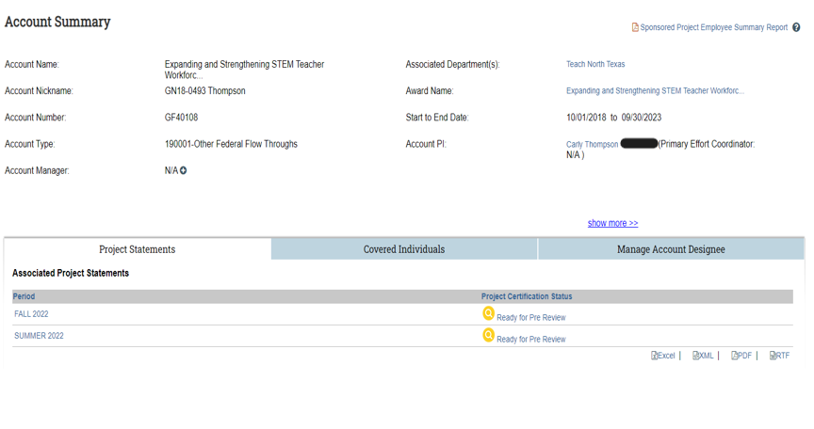
ECC Project Account Summary

Slide 20
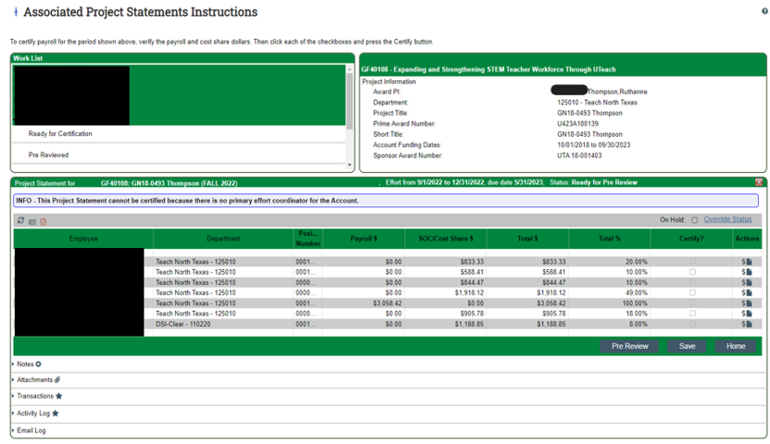
ECC Project Statement Pre-review Page

Slide 21
Important Points about Effort Reporting
The Principal Investigator (PI) must still review, confirm, and certify that the salary charged and the cost share contributed to the project are accurate.
The PI must also review that the salary charged is reasonable in relation to the work performed in support of the project even after a pre-review.
In rare occasions, where someone other than the PI certifies (e.g., the chair, laboratory manager or project manager), the method of verification used by the signer should accompany the Project Statement (attachment).

Slide 22
Important Points about Effort Reporting
If the effort percentage certified is lower than the payroll distribution percentage, a cost transfer must be made to remove any excess salary charges.
Use the correct percentage on the EPAR for direct charges or cost shared payroll to ensure that the person’s effort is correctly reported in COGNOS.
Project Statement recertification is not required if the amounts charged are substantially correct, often defined as +/- 5 percentage points.
Please contact GCA - Isaac Collins or project admin in GCA with any questions!

Slide 23
Project Statements
Changes:
  ECC collects payroll data daily so updated ePAR data should appear the morning after final approval.
  If a project statement was certified in error and the percentage of effort differs significantly from the employee’s actual effort, defined as +/- 5 percentage points of total effort, a project statement can be re-opened by Central Administration (GCA – Isaac Collins, Sally Pettyjohn, and Charles Tarantino) then recertified by the PI.
  Project statements will all be done through the ECC system (there should be no manual project statements).

Slide 24
ECC Best Practices
Pre-reviewers should meet with PIs at the beginning of the effort reporting period to determine who will be working on the sponsored project and how much is being paid from the project for all individuals (Meeting should occur between January & February for first period and between July & August for second period).
Pre-reviewers should also be aware if a grant has cost share. Cost Share will be set up via an ePAR to document it in the payroll ledgers which will result in it being shown on project statements.

Slide 25
ECC Best Practices cont.
Pre-reviewers should also meet with PIs 60 days before the end date of the reporting period to ensure any changes needed to payroll are processed via ePAR to ensure accurate payroll data on projects (May for first reporting period and November for the second reporting period).
When the pre-review period opens, complete your review as quickly as possible, due to time constraints on when ePARs must be submitted for fiscal year end/close.

Slide 26
Timeline for System Training
Training within ECC will Tuesday July 25th and Thursday July 27th from 2:00 – 3:30pm
Instructional documents will be available online at research.unt.edu/grams along with training videos.
PI training to begin in August.

Slide 27
Office of Grants and Contracts Research Administration
Isaac Collins, Financial Analyst, x2249
isaac.collins@unt.edu
Sally Pettyjohn, Sr. Administrative Coordinator; x3940
sally.pettyjohn@unt.edu

